Slide 1
Facilitating Adult Education
Kalli Varaklis, MD, MMEdL
Department of Ob/Gyn

Slide 2
Spoiler
Adult learners want to know WHY they need to know what they want to know
Adult learners want to know WHAT they need to know
Adult learners what to APPLY what they just learned

Slide 3
So, as adult learners yourselves….
Why should you learn about facilitating adult education?
As medical educators you will be dealing with adult learners all of the time – learning about unique characteristics of adult learners can maximize their education and your satisfaction with teaching
What do you need to know?
What are the characteristics of adult learners? How best to act as a facilitator? What is experiential learning?
How can you apply what you have learned?
Interactive discussion
Case studies on challenging adult learners

Slide 4
Objectives
Why do adults learn?
Characteristics of adult learners
Knowles
Experiential Learning
Facilitating Adult Learners
Application: Cases of Challenging Adult Learners

Slide 5
Definition of Adult Learner
A self-directed person who is engaged in what they want to learn, ready and motivated to learn and willing to incorporate their life experiences into what they are learning
Why do adults seek learning?

Slide 6
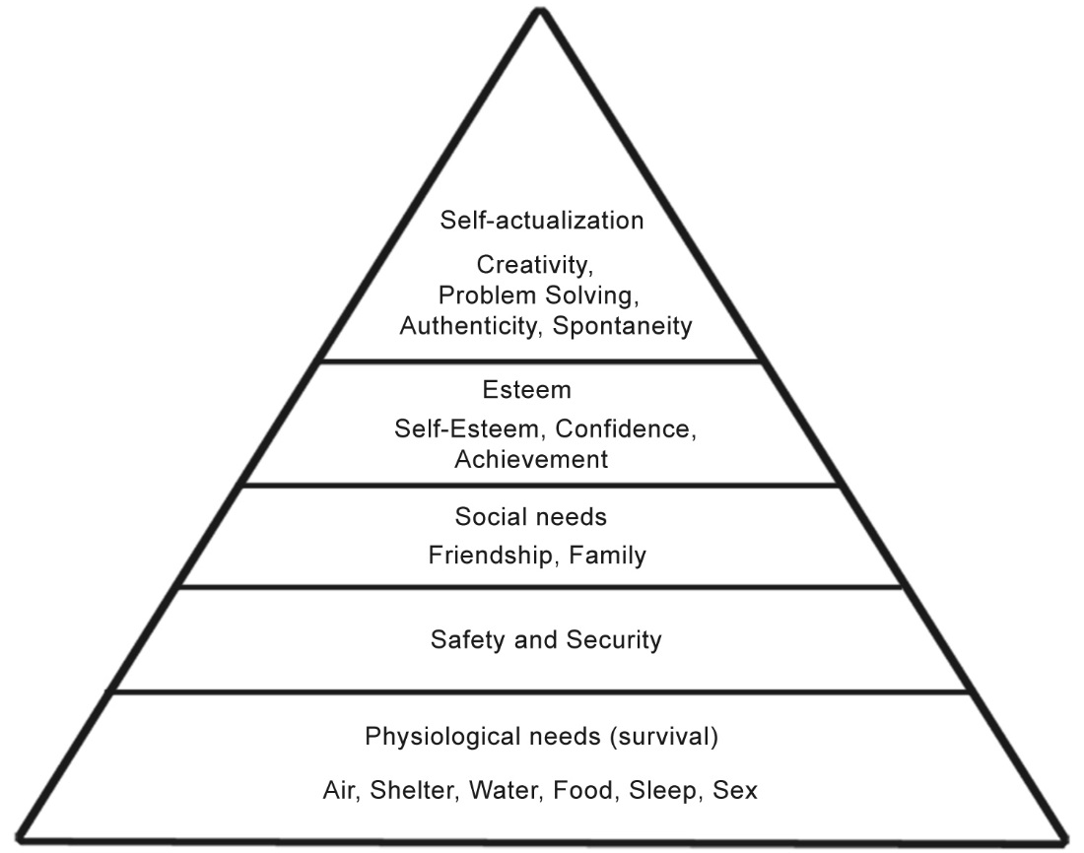
Maslow’s Hierarchy of Needs

Slide 7
Power/Load Balance
Adulthood is a balance between amount of energy that is needed (Load) to complete a task and the amount of energy available (Power)
Load
External pressures: family, work, community
Internal load: aspirations, desires, personal goals
Power
External sources: family support, finances, work flexibility
Internal sources: resiliency, health, internal motivation, resiliency
Only when power > load can an adult engage in learning
McCluskey (1970)

Slide 8
Adult educational experiences should be life-enhancing:
Enhance growth towards realizing full potential and personal goals
Increase adaptability to both internal and external changes
Promote self-concept, self-esteem
Promote creativity
Provide access to opportunity (defined by the adult learner)
Boggs (1981)

Slide 9
Andragogy
“leader of men”
The art and science of helping adults to learn
As compared to pedagogy
Word was coined in the 1830’s by Alexander Kapp
Father of Andragogy was Malcolm Knowles (1980’s) who proposed 4+2 assumptions about the learning needs of adults

Slide 10
Pedagogy
Teacher driven
Make all the decisions about what is learned
Learners are dependent on teacher
Learners’ experience is not relevant
Subject centered, told what they need to learn
Motivation is extrinsic
Pleasing adults
Getting good grades

Slide 11
Knowles’ 4 Principles Of Andragogy
Adults need to be involved in the planning and evaluation of their instruction
Experience (successful and unsuccessful) provides the basis for the learning activities
Adults are most interested in learning subjects that have immediate relevance and impact to their job or personal life
Adult learning is problem-centered rather than content-oriented

Slide 12
Knowles Assumptions of Andragogy
Need To Know
Self-Concept
Experience
Readiness to Learn
Orientation to Learn
Motivation to Learn

Slide 13
Knowles Assumption #1
The Need to Know
How will learning occur?
What will be learned?
Why it is important to learn?
What are the benefits of knowing
What are the risks of not knowing
Important to include adults in planning out what they want to know and to involve them in goal setting and expectations (theirs and yours)

Slide 14
Knowles Assumptions of Androgogy
Need To Know
Self-Concept
Experience
Readiness to Learn
Orientation to Learn
Motivation to Learn

Slide 15
Knowles Assumption #2
Self-Concept
Adults have a well developed sense of self
Self-directed learners
Management of learning
Motivation to learn
Ownership
for what to learn and how to learn it
Varies in the context of different learning situations
Mandatory ICD-10 e-learns compared to META sessions

Slide 16
Self-Directed Learning
defined as the process in which individuals take on the responsibility for their own learning process by diagnosing their personal learning needs, setting goals, identifying resources, implementing strategies and evaluating the outcomes
Three variables involved with self-directed learning:
the goals
the process
the learner
In an adult learning context, the goals are generally self-determined, as is the process. Self-directed learning can be enhanced with facilitation, particularly through providing resources.
Motivation is key to a successful self-directed learning experience.

Slide 17
Advantages of Self-Directed learning
Integrated with daily routines
Triggered by an internal or external motivation
More meaningful and worthy
An inductive process of reflection and action
Linked to learning of others

Slide 18
Disadvantages of Self-Directed learning
Being self-directed can be very much related to the situation
May be self-directed in one circumstance and not in another, motivation
Not all adults are good self-directed learners
Due to confidence, independence and/or availability of resources
Even self-directed learners may prefer a variety of learning styles
Many prefer a mix of self- and teacher-directed learning
learners can easily be distracted by their own needs, assumptions, values, and misperceptions and priorities

Slide 19
How can we Apply this to clinical teaching?
Facilitating
Checks
Motivational encouragement
Don’t rely just on self-directed learning techniques – know your students

Slide 20
Knowles Assumptions of Andragogy
Need To Know
Self-Concept
Experience
Readiness to Learn
Orientation to Learn
Motivation to Learn

Slide 21
Knowles Assumption #3
Experience
Adults have a diverse wealth of life experience that can – and MUST - be drawn upon to provide a context for their learning
However, as adults are defined, to some degree, by their experience – can lead to biases and reluctance to “unlearn” or “relearn”
Personal experience can influence motivation to learn and value
Active, constructive and collaborative

Slide 22
Knowles Assumptions of Andragogy
Need To Know
Self-Concept
Experience
Readiness to Learn
Orientation to Learn
Motivation to Learn

Slide 23
Knowles Assumption #4
Readiness to Learn
Timely
Adults want to learn what is immediately relevant
(as well as what may be useful in the future)
Relevant
Conflict between personal goals and goals that may be enforced by society or employment (ICD-10 tutorial and META scholars content)
Useful
How will this improve my life? Personal judgment that will vary from learner to learner

Slide 24
Knowles Assumptions of Andragogy
Need To Know
Self-Concept
Experience
Readiness to Learn
Orientation to Learn
Motivation to Learn

Slide 25
Knowles Assumption #5
Orientation to Learn
Focused on tasks and subject
Problem-centered
As opposed to content centered
Experiential learning most effective for adult learners

Slide 26
Experiential Learning
Tell me, and I will forget. Show me, and I may remember. Involve me, and I will understand.
Confucius, circa 450 BC

Slide 27
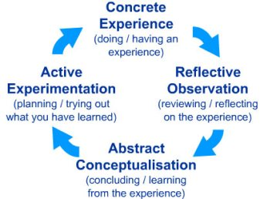
David Kolb – Experiential Learning Cycle

Slide 28
Advantages of Experiential Learning
Because experiential learning theory builds on experience – adults can bring a wealth of experience to every learning situation
holistic learning approach
Relate learning to all aspects of each individual
Can be extremely effective when the learning has intrinsic motivation

Slide 29
Disadvantages of Experiential Learning
Experiential learning theory does not take into account differences in cultural experiences or conditions
Teachers of ESL may have a group of learners who have very similar motivation for learning, but not the same experiences
May need facilitation for experiential learning around change and new experiences

Slide 30
Knowles Assumptions of Andragogy
Need To Know
Self-Concept
Experience
Readiness to Learn
Orientation to Learn
Motivation to Learn

Slide 31
Knowles Assumption #6
Motivation to Learn
Extrinsic
Job requirement, increased status, money, influence
Professional advancement
Social relationships
Social welfare
Intrinsic
More likely in adults
Escape/stimulation
Cognitive interest – learning for the sake of learning

Slide 32
Limitations of Andragogy
Does not emphasize reflection
Under-emphasizes the role of the teacher as motivation
Underestimates the diversity of adult learners
Focuses on strong personality traits that may not be well developed in all/many learners
Not separate dicta, but rather fluid tenets of teaching arts to be applied in conjunction with adult learners

Slide 33
How do we best facilitate adult learning?

Slide 34
Learning Environment
Safe
Mutually respectful
Partnership and coaching
Very old, classic study illustrated that adult education was facilitated when adult learners had control over what they learned, when they learned it and the context/direction of the learning (Rogers 1969)
Be encouraging of the process, but help the learner focused on the/their goal of learning
Adults want to be self-directed and take a leadership role in their learning

Slide 35
Facilitating Adult Learners
Consider the steps and processes of adult learning, as opposed to the content that needs to be learned
Different adults get “stuck” on different steps of the process
Need To Know
Self-Concept
Experience
Readiness to Learn
Orientation to Learn
Motivation to Learn

Slide 36
Facilitating Adult Learners
Involve adults in the planning and evaluation of their instruction
When possible
Try to determine extent of self-directed learning component
How do different adult learners want evaluation?
Offer learners the opportunity to evaluate the instruction

Slide 37
Facilitating Adult Learners
Experience
acknowledge prior knowledge and experiences of learners
Mistakes
Offer your own experience with mistakes
Encourage reflection of learner mistakes (start the Kolb cycle)
Encourage learners to question their (and each other’s and even your) assumptions
Try to appreciate the individuality of each unique learner
Merriam, 1999

Slide 38
Facilitating Adult Learners
Consider content carefully
Most adults are interested in learning about subjects that have immediate relevance to their job or personal life
Allow opportunity for application of learning to relevant problems
Have learners bring real-life problems to the learning environment
Encourage small group problem-solving with judicious facilitation

Slide 39
Facilitating Adult Learners
Role Model
Teaching approaches
Reflection
Offer insights as to the process of learning
respect
Remain open-minded
Consider different perspectives, cultures
Try to maintain as neutral as possible, share your perspective only when you believe that they will be useful as proxy experiences
Students report better learning when they feel as though they have been listened to, as opposed to being evaluated or being judged (Carl Rogers)
Reflect on shared experiences

Slide 40
Facilitating Adult Learners
Present well-prepared, clear presentation
Adults have limited time and, if sitting in a teacher-directed activity - want to get the most out of their (valuable) time
adult learners are more experienced and expect quality presentations
Time management
Always be punctual
Pace the learning
Leave time for questions

Slide 41
Facilitating Adult Learners
Communicate Expectations
Set clear rubrics
Know the policies of the course
Know what you don’t know
Provide reading material ahead of the class, as well as resources for further reading
Provide Constructive Feedback
Clear
Specific
Timely
http://www.facultyfocus.com/articles/teaching-and-learning/understanding-adult-learners-needs/#sthash.ddeL7a9Q.dpuf

Slide 42
Thoughts? Questions?
It’s hard to ask questions on an e-learn, but feel free to contact me at varakk@mmc.org
Applying what you have learned…..

Slide 43
Challenging Case #1
You are a pediatrician who has agreed to cover the inpatient service for two weeks. You are one week into the six week rotation and notice that one of the students, Justine, seems very disinterested in the rotation. She appears bored most of the time, and shows up for duty several minutes late every day. She is on her cell phone whenever possible and the only question she has asked so far is, “what do I need to learn to get a good grade on the shelf exam?” When questioned, she mentions that she wants to be an orthopedic surgeon and doesn’t know why she needs to spend 6 weeks on a “veterinary” rotation.

Slide 44
Knowles Assumptions of Androgogy
Need To Know
Self-Concept
Experience
Readiness to Learn
Orientation to Learn
Motivation to Learn

Slide 45
Challenging Case: Pedi Ortho
Need to Know
Yes, this is an adult-learner, but with very little experience in medicine
Help student understand why it is important to learn pediatrics
What are the benefits of knowing
What are the risks of not
Engage with the student to define what their goals for the rotation are and what they should be
Self-Concept
This student has an unusually well-defined medical self-concept, for level of training
Explore with student, professionalism?
Experience

Slide 46
Challenging Case: Pedi Ortho
Readiness to Learn
Timely/Relevant
Adults can want to learn what is immediately relevant as well as what may be useful in the future
Relevant
Conflict between personal goals and goals that may be enforced by society or employment
Useful
How will this improve my life?
Direction – how much support

Slide 47
Challenging Case: Pedi Ortho
Orientation to Learn
Experiential learning
Perhaps steer student to pediatric clinical situations
Motivation to Learn
Intrinsic
Extrinsic
Role model to residents and other faculty

Slide 48
Challenging Case #2
You are in a four person internal medicine practice in Anytown, Maine. Your group’s philosophy is that every patient is everyone’s patient and you cross-cover for each other when on call. Over the last several years you have noticed, when on call, that one of your partner’s management plans are not evidence-based and reflect standards of over a decade ago. You are aware that she chooses to go to educational conferences in exotic locations and she has laughed that she never goes to the lectures. There has been a recent case with a poor outcome that you feel is related to your partner’s medical knowledge.

Slide 49
References
Knowles, Malcolm, Self-Directed Learning: A Guide for Learners and Teachers 1975
Checkering, A. W., & Gamson, Z. F. (1987). Seven Principles For Good Practice In Undergraduate Education. AAHE Bulletin, 3-7.
CHAO Jr, Roger “Understanding the Adult Learner’s Motivation and Barrier to Learning” European Society for the Research on Adult Learners, 6-8 November, 2009
http://www.ncbi.nlm.nih.gov/pmc/articles/PMC117453/
Hartzell JD. Adult learning theory in medical education. Am J Med. Nov 2007;120(11):

Slide 50
References
Brookfield, Stephen D. “Understanding and Facilitating Adult Learning” School Library Media Quarterly, v16 n2 p99-105 Win 1988
Norman GO: The adult learner: A mythical species. Acad Med 74: 886 889, 1999. 886-
Slotnick HB: How doctors learn: Physicians’ self directed learning episodes. Acad Med 74: 1106 17, 1999.
http://www.facultyfocus.com/articles/teaching-and-learning/understanding-adult-learners-needs/

